Slide 1
Introduction to Rust

Slide 2
Not Sponsored or affiliated with or approved by The Rust Foundation

Slide 3
Agenda
To Learn Rust Obviously (That’s why you’re here, [hopefully])
What is Rust ?
How Rust Works ?
Rust Features
Rust Hands-on
Why Rust ?
Conclusion

Slide 4
Install Rust, Clone Repo, Install VS Code Extensions
https://www.rust-lang.org/tools/install | https://play.rust-lang.org/
Repo Link: https://github.com/damletanmay/intro-to-rust
rust-analyzer, Cargo Scripts, Code LLDB, crates

Slide 5
Terminologies
Compiler
ABI (Application Binary Interface)
Library Crate, Binary Crate
Garbage Collector
Mutability, Immutability
Shadowing
Memory Management
Stack
Heap

Slide 6

History
Origins | Mozilla Support | Evolution | Rust Foundation
2006 | 2009 | 2012-2020 | 2021
Graydon Hoare’s Personal Project | Servo Browser | Type System changes, Removing Garbage Collector, yada yada yada | AWS, Facebook, Google, Microsoft, Huawei, Mozilla

Slide 7
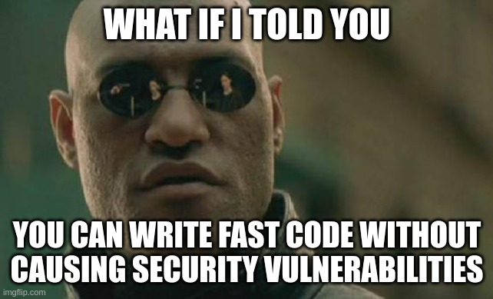
What is Rust ?
A Systems Programming Language which ensures memory safety, concurrency, type safety, concurrency without race conditions and is blazingly fast.
Most loved programming language on stack overflow survey since 2016.
You’ll kind of understand what it is by the end of the session (hopefully hehew)

Slide 8
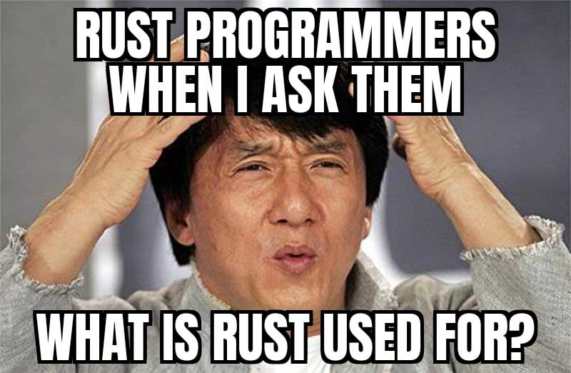
Rust Features
Zero Cost Abstractions
RAII (Resource Acquisition is Initialization)
Algebraic Type System
Polymorphism (Traits and Generics)
Async Programming
Fearless concurrency
Meta Programming (Macros)
Cargo

Slide 9
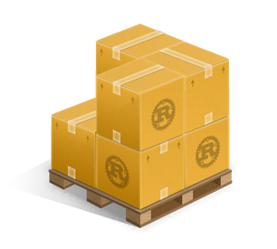
How Rust Works
Rust Crates (Crates.io)
No Common Shared object which is already compiled i.e. no Library.
Every code you write in rust is either a binary crate or a library crate.
Binaries make executables and Libraries just compile the code for further use.
And yes, it obviously has a compiler.

Slide 10
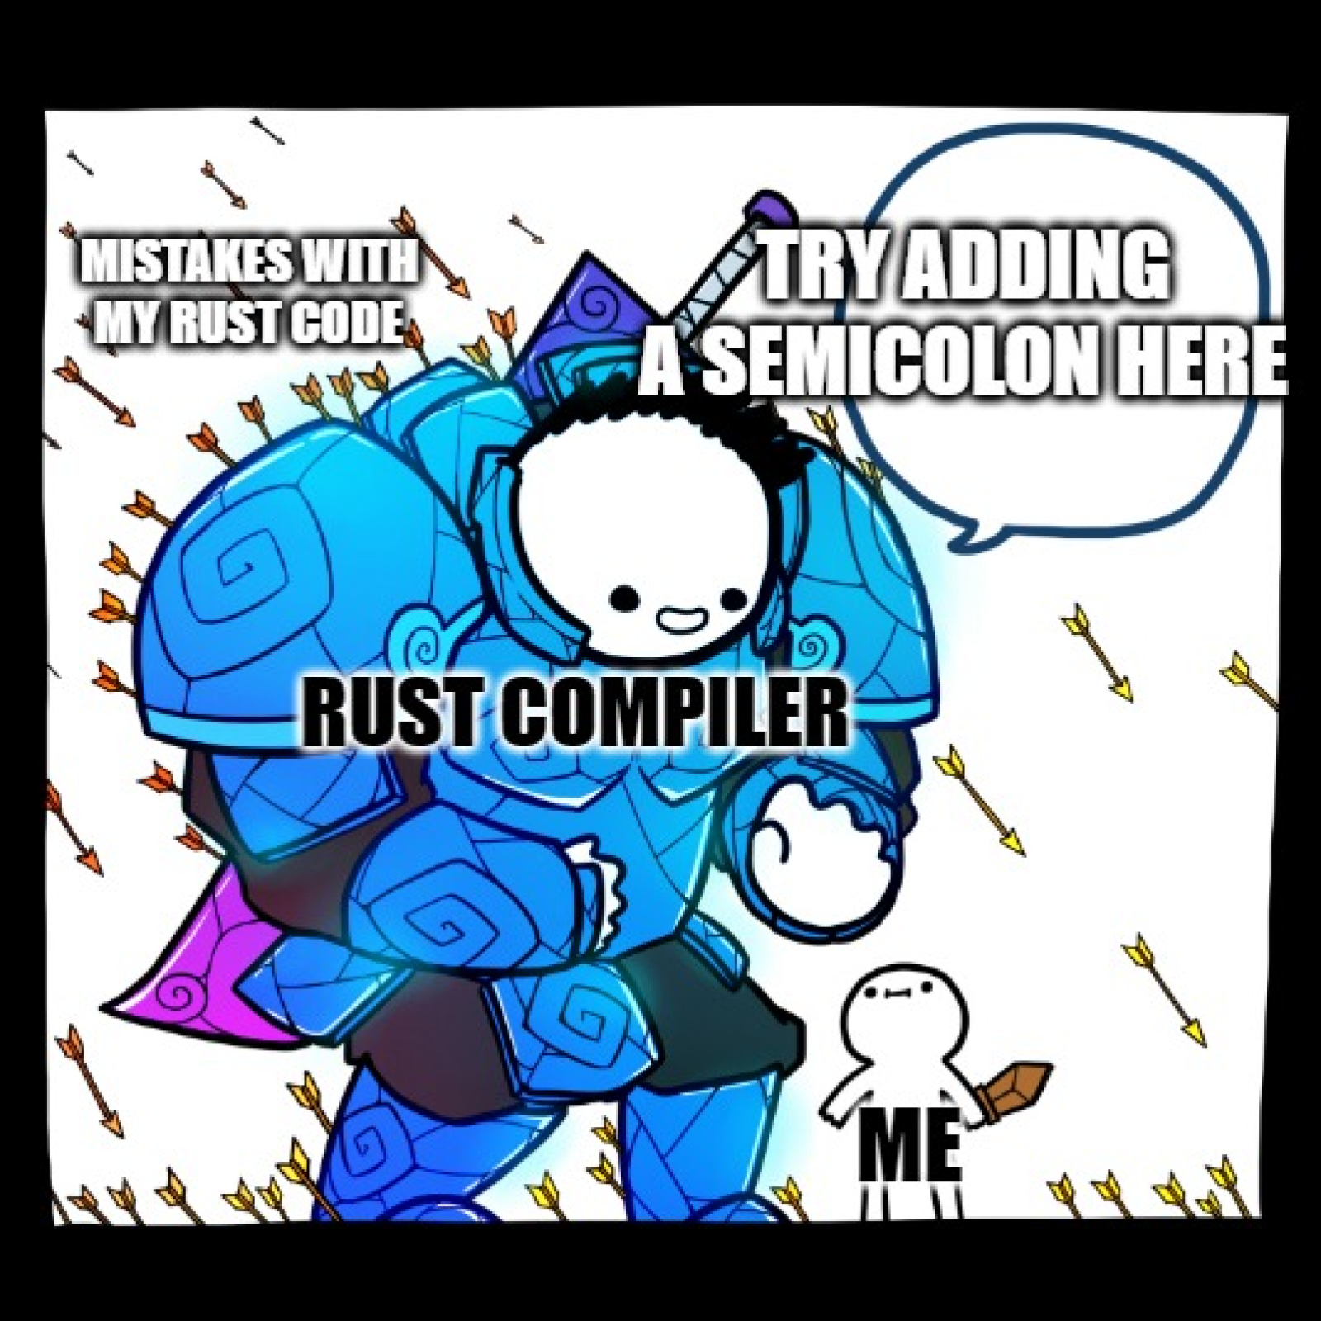
Rust Demo – Create A Binary
Create a new binary or whatever via cargo new [name_of_the_binary]
Run Via cargo run main.rs
Without cargo, we can also use rustc [filename.extension]

Slide 11
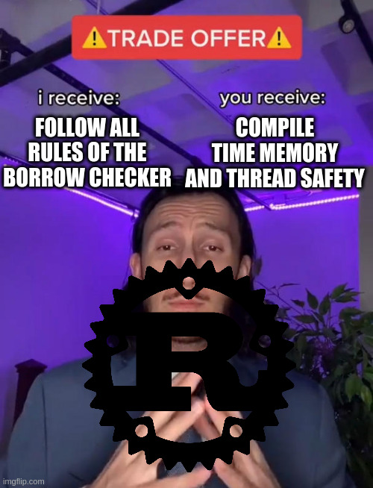

Ownership and Borrowing, Borrow Checker

Slide 12
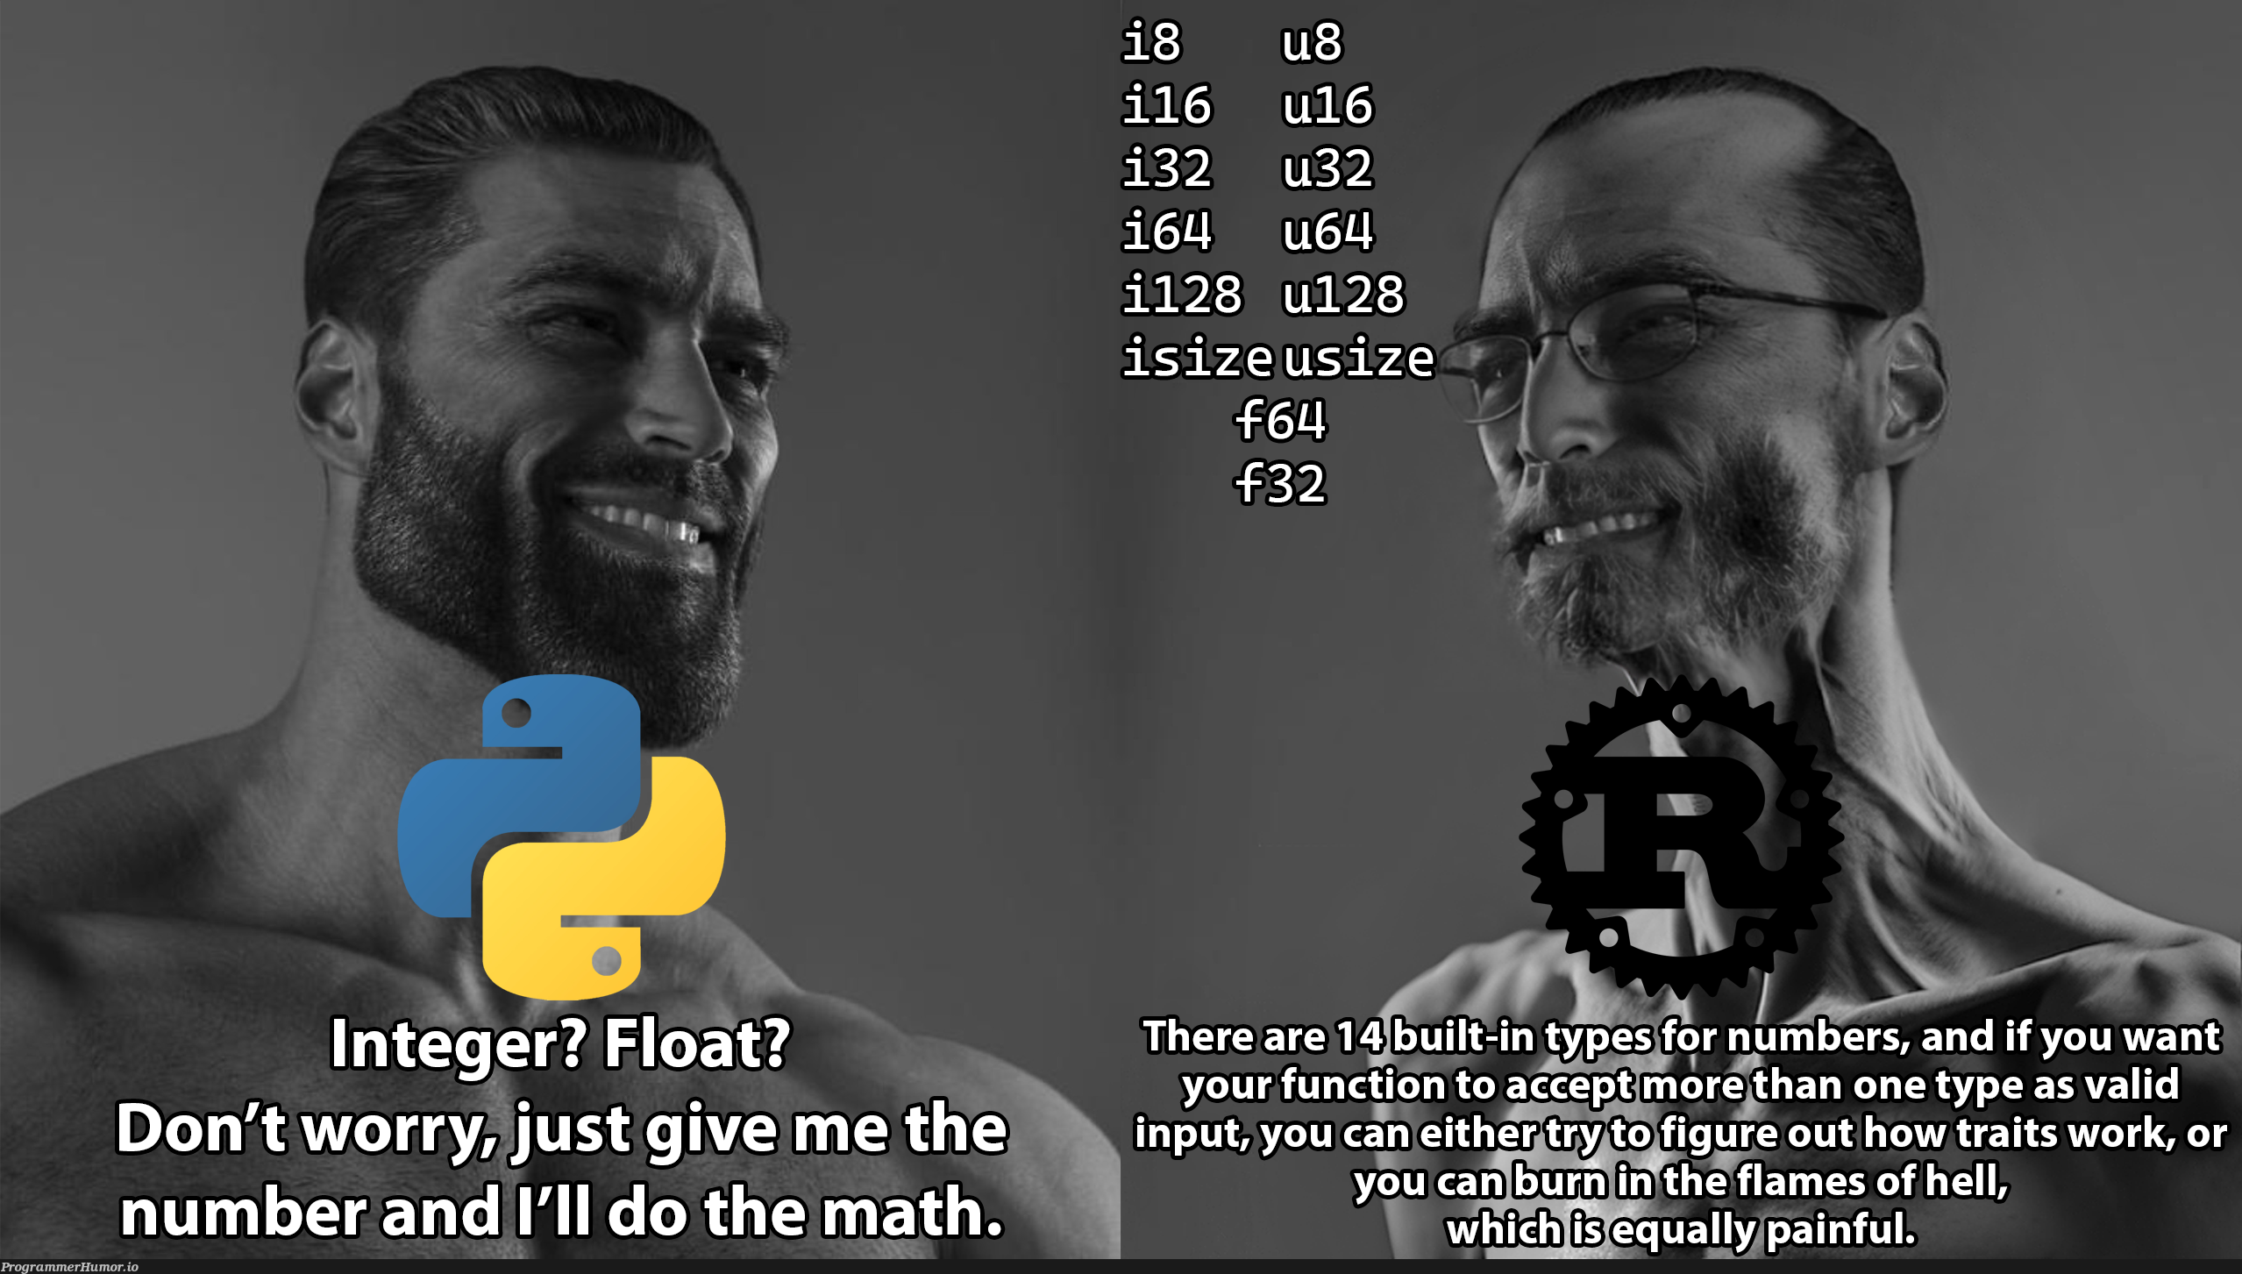
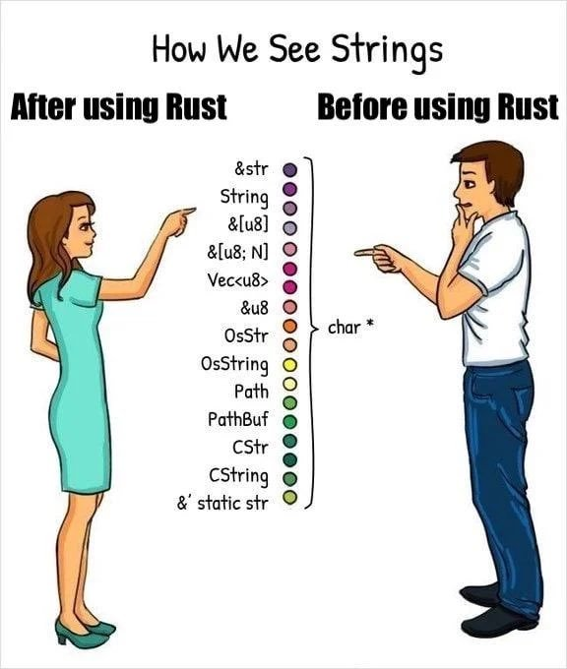
Basics
let, const to define your variables
mut keyword to add mutability
Stack Variables:
i8 – i128
f16 – f128
char, str, bool
u8 – u128
Tuple, Array
Heap Variables:
String
Vector
Option, Result

Slide 13

Loop, While Loop, For Loop
loop {}
while {}
for i in 1..100{}

Slide 14

Functions, Structs, Tuple Structs, Enums
fn name() -> return type {
}
struct name{
….
}
struct name(){}
enum name {
…
}

Slide 15
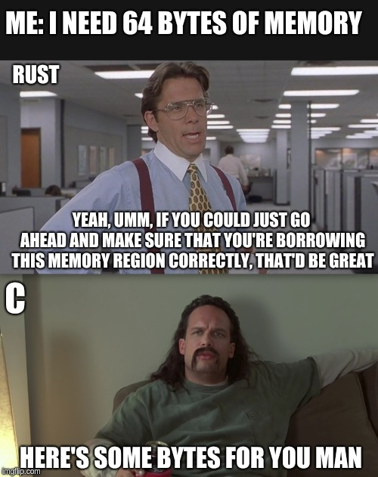
Why Rust though ? Why not C, C++, Java or python ?

Slide 16
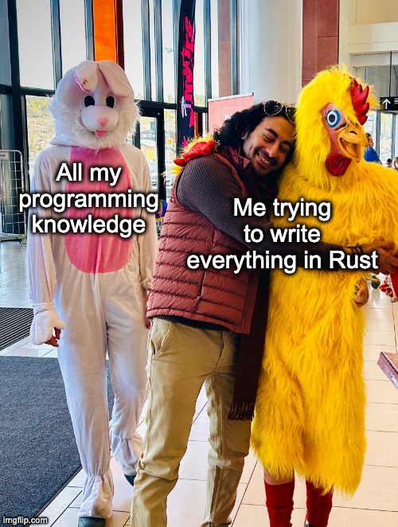
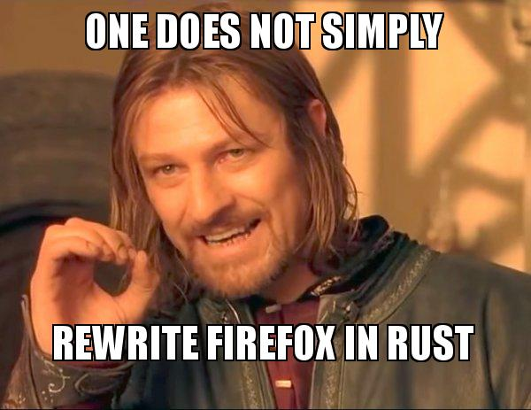
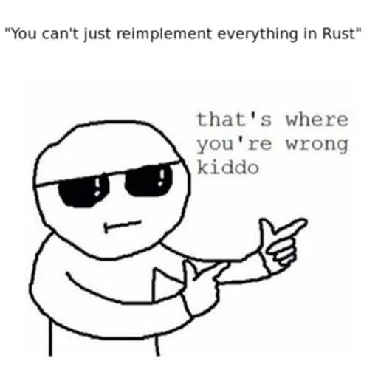
Conclusion

Slide 17

Questions & answers damlet@uwindsor.ca

Slide 18

Connect on LinkedIn

Slide 19
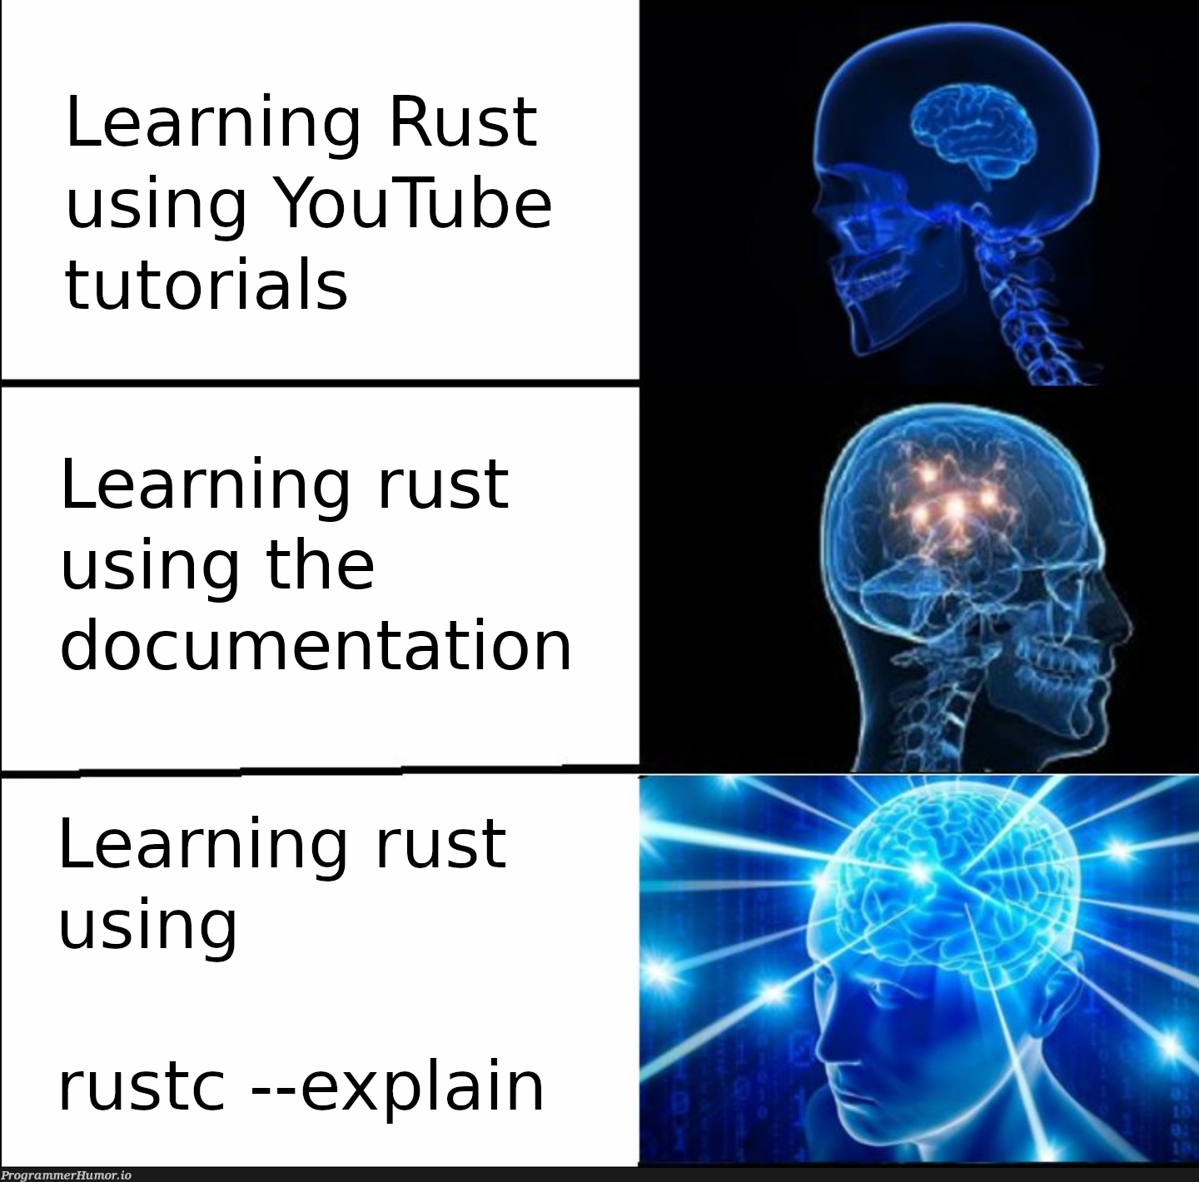
Resources
What now ?
Resources to Learn Rust
https://doc.rust-lang.org/stable/book/
https://www.youtube.com/@letsgetrusty
https://www.youtube.com/watch?v=BpPEoZW5IiY&t
https://www.youtube.com/watch?v=2hXNd6x9sZs&t
Check out some stuff made in Rust
https://oxc-project.github.io/
https://deno.com/
https://turbo.build/pack
https://github.com/HigherOrderCO/Bend
https://tauri.app/

